Slide 1

CAPSTONE PROJECT
Steganography
Presented By: GANESH KANOJIYA
Student Name : GANESH RANMAYAN KANOJIYA
College Name & Department : KIET GROUP OF INSTITUTIONS & COMPUTER SCIENCE AND INFORMATION TECHNOLOGY (CSIT)

Slide 2
OUTLINE
Problem Statement
Technology used
Wow factor
End users
Result
Conclusion
Git-hub Link
Future scope

Slide 3
Problem Statement
With the rise of cyber threats and surveillance, secure communication has become a necessity. Traditional encryption methods attract attention, whereas steganography allows users to secretly embed messages within images without raising suspicion. This project aims to develop a user-friendly, password-protected steganography tool to hide and extract confidential messages securely.

Slide 4
Technology used
Python – Core programming language
Tkinter – GUI development for an interactive user experience
Pillow (PIL) – Image processing library
Stegano (LSB Encoding) – Hides text inside image pixels
File Handling – Saving encrypted images securely
Messagebox (Tkinter) – User notifications

Slide 5
Wow factors
Password Protection – Users can manually set a password for encryption and decryption.
User-Friendly GUI – No command-line complexity, easy-to-use interface.
Secret Message Embedding – Conceals text inside images without altering their appearance.
Custom Save Option – Users can choose where to save the encoded image.
Error Handling & Security – Prevents unauthorized access with incorrect passwords.

Slide 6
End users
Cybersecurity Enthusiasts – Learning cryptography & steganography.
Journalists & Activists – Securely share sensitive information.
Law Enforcement & Intelligence Agencies – Secret data transmission.
Students & Researchers – Educational purposes in security studies.
General Public – Protect personal information from prying eyes.

Slide 7
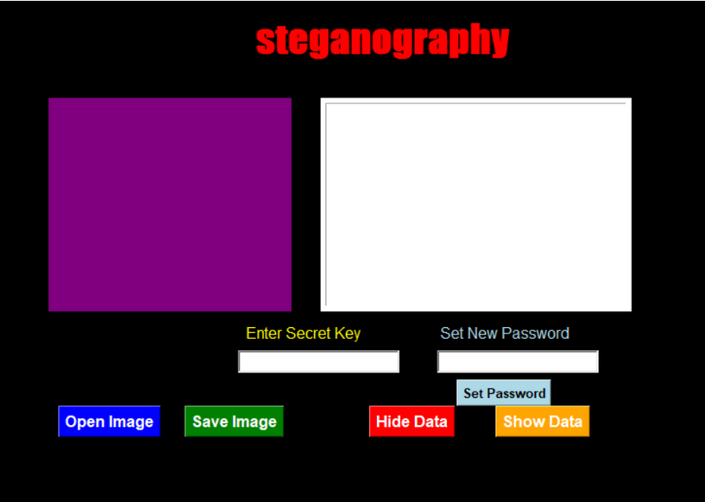
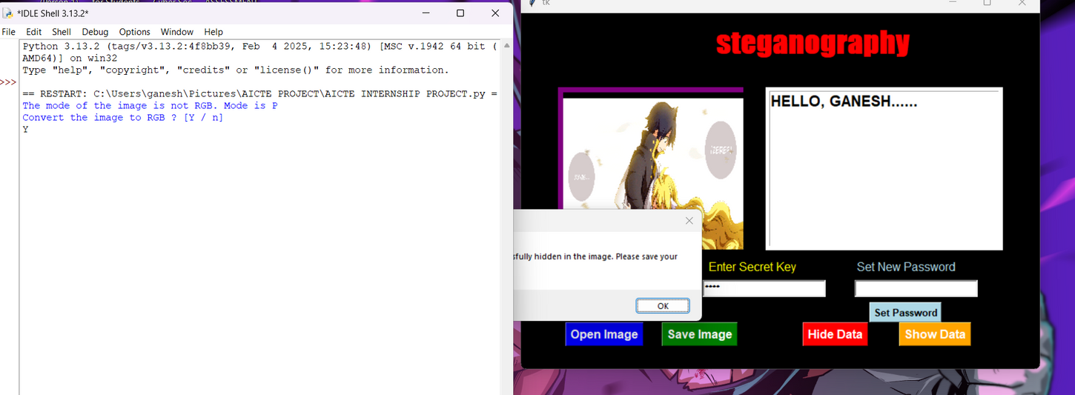
Results
After choosing the image and set the new password after that put the same key in your Enter secret key and Put your HIDDEN message in that then click on HIDE data and then you have to click on Y in python IDLE because of Storage permission then it will save the message and password in your image then you have to click on the save image then save your image in your storage.
From the open image choose the image from your device

Slide 8
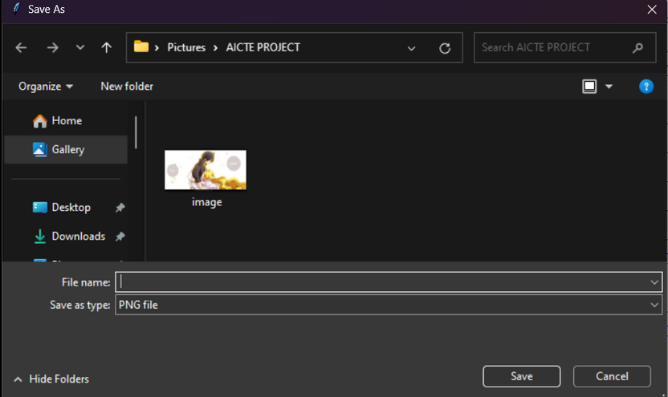
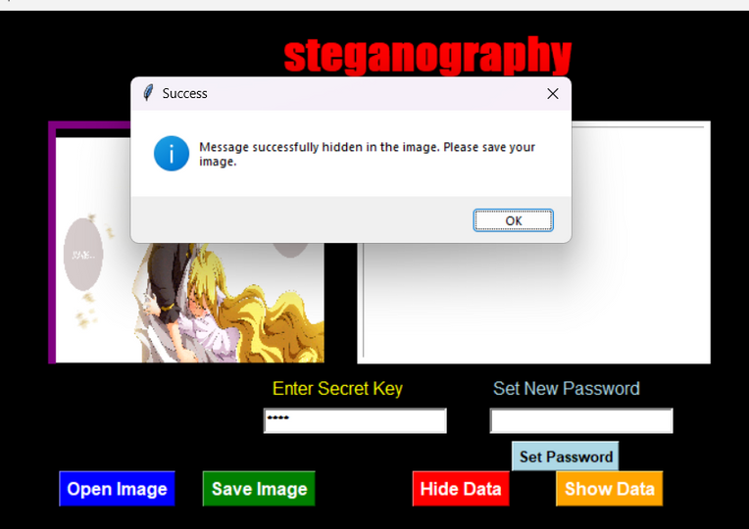
Results
after clicking on save image
After click y in your IDLE PYTHON
NOW YOU HAVE ENCRYPTED IMAGE OF YOURS

Slide 9
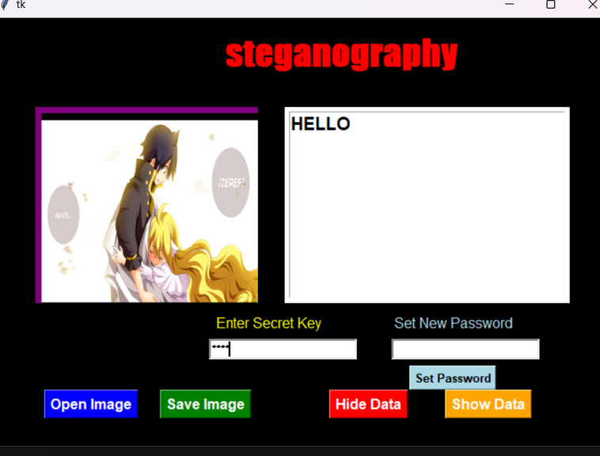
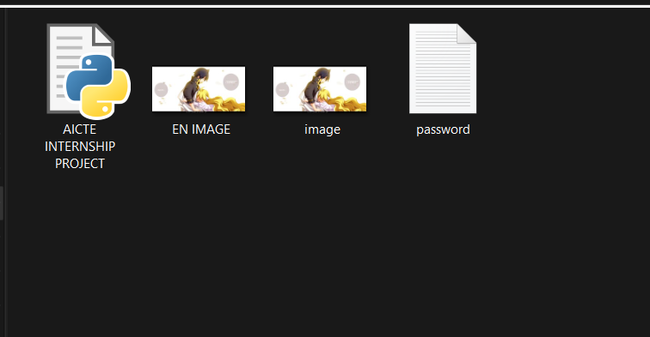
Results
AND PUT YOUR CODE YOU WILL GET THE IMAGE INFORMATION
NOW CHOOSE YOUR FILE FOR DCRYPTION FILE

Slide 10
Conclusion
This project provides an efficient, secure, and user-friendly solution for steganographic message hiding. Unlike standard encryption, it allows covert communication by embedding text in images. The system enhances cybersecurity and privacy while being simple enough for general users.

Slide 11
GitHub Link
https://github.com/justt-zeref/AICTE-Steganography

Slide 12
Future scope(optional)
🔹 Advanced Encryption – Integrate AES/RSA for dual-layer security.
🔹 Multi-File Support – Expand to videos, audio, and GIFs.
🔹 Mobile & Web App – Build an Android, iOS, or cloud-based version.
🔹 AI-Based Image Selection – Optimize image quality for better concealment.
🔹 Blockchain Integration – Secure and verify encrypted images with tamper-proof technology.
🔹 Deep Learning for Detection Resistance – Prevent steganalysis attacks with randomized pixel selection.

Slide 13
THANK YOU

